Slide 1

BRITISH AIRWAYS
WEB SCRAPING TO GAIN THE COMPANY INSIGHTS

Slide 2
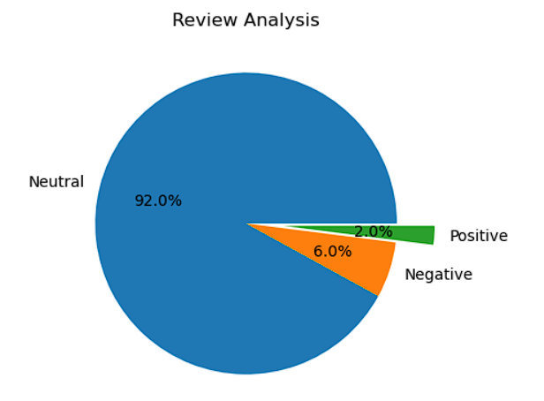
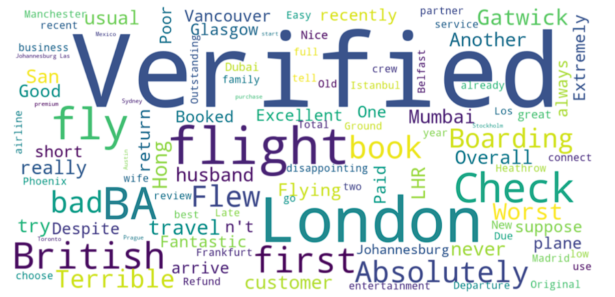
INSIGHTS FROM THE CUSTOMER REVIEWS
After seeing 1790 reviews, we got to know that:
- 1647 were Neutral reviews
- 107 were Negative reviews
36 were Positive reviews
Word cloud of Keywords used in reviews

